Slide 1
Comparison After vs Before Updating

Slide 2
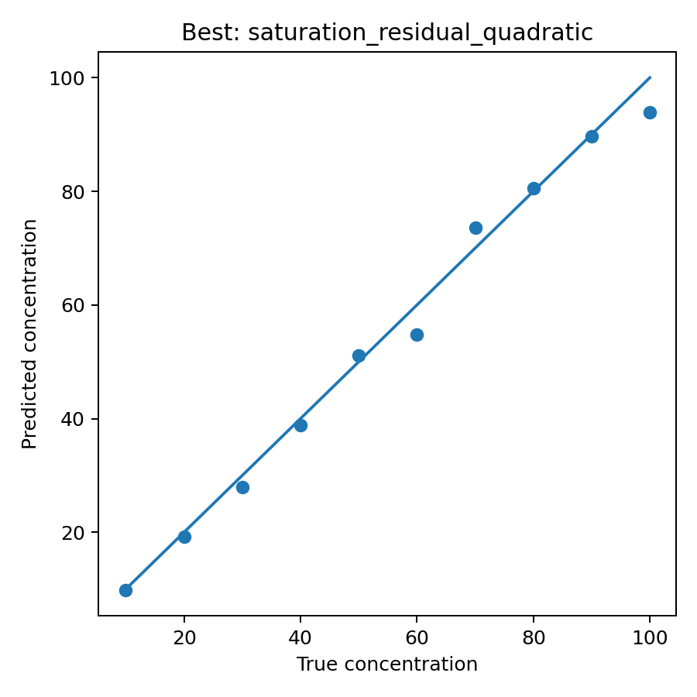
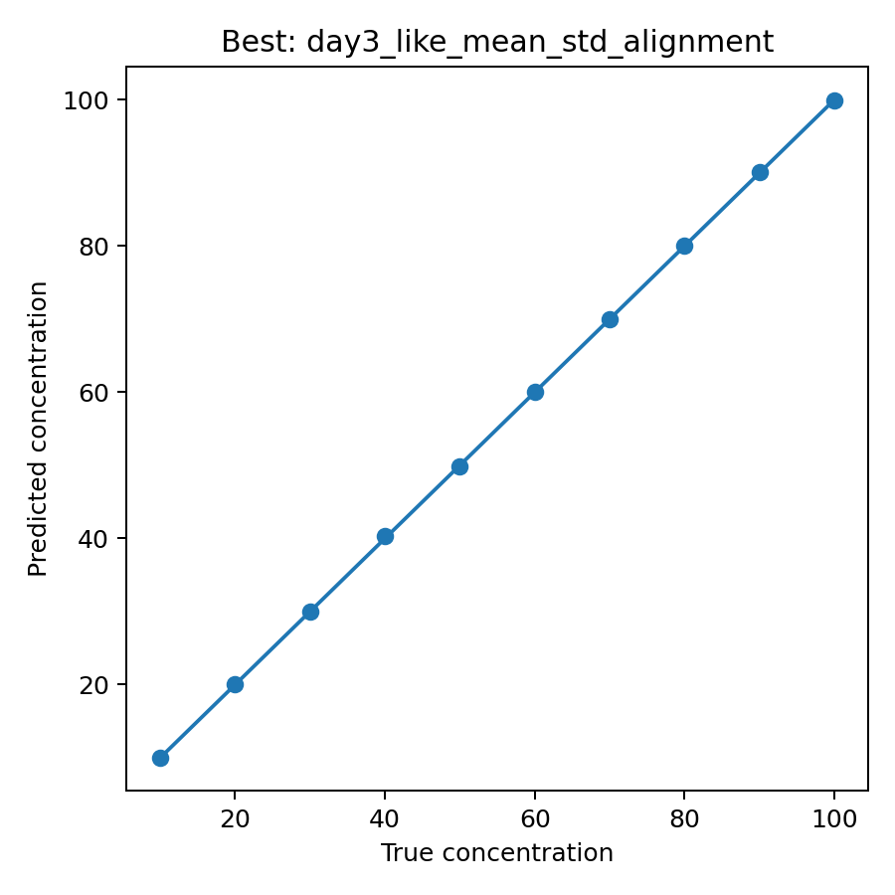
day4_prediction_vs_true_best.png
Figure 1 After Updating
Figure 2 before Updating

Slide 3
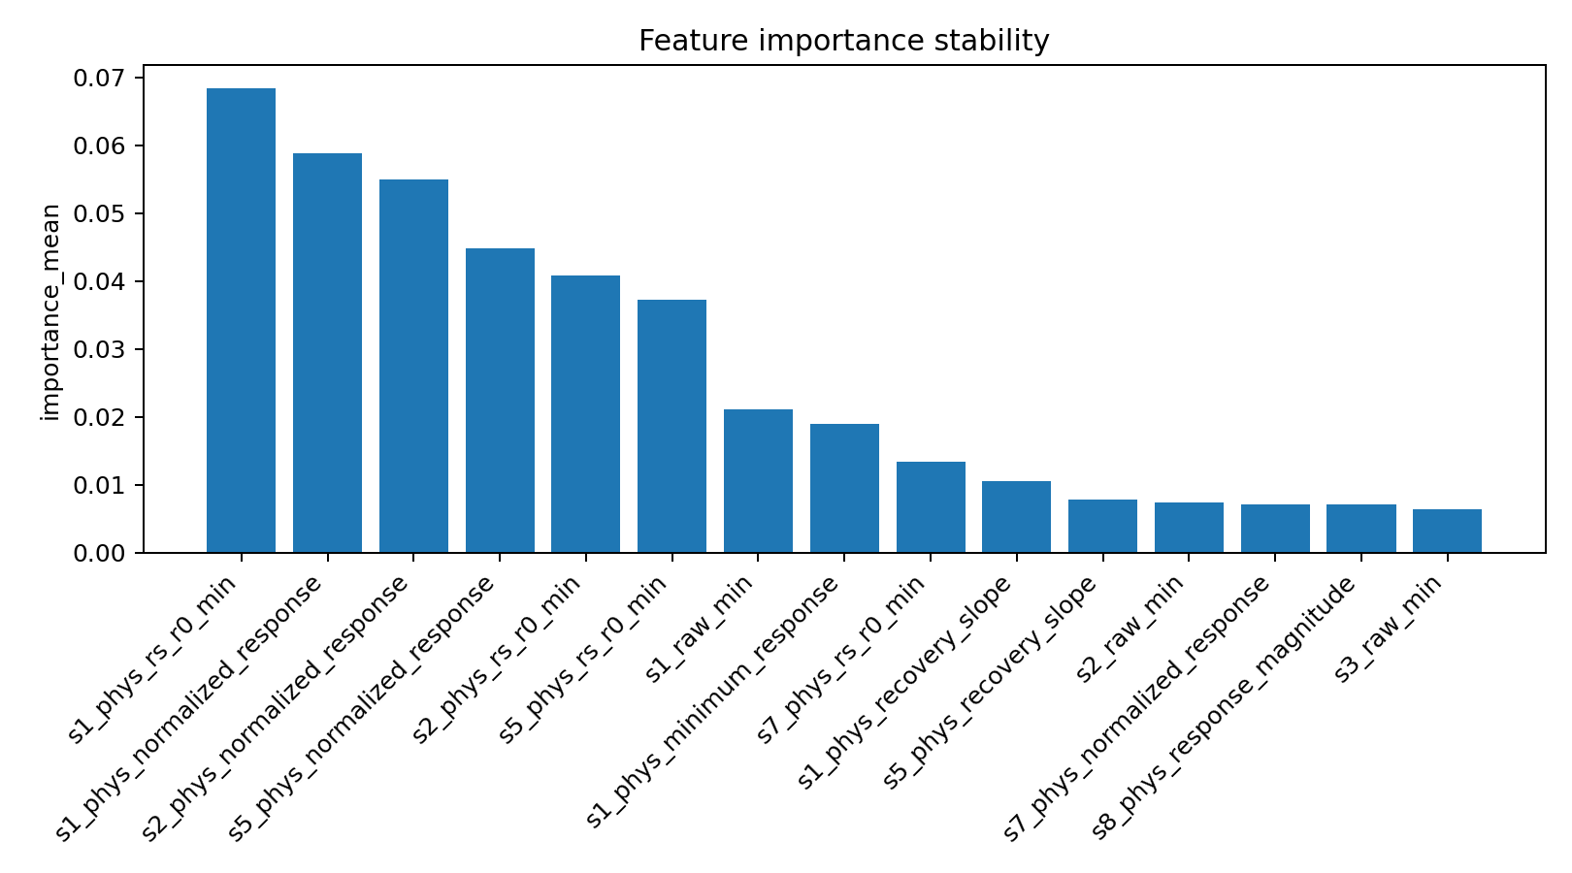
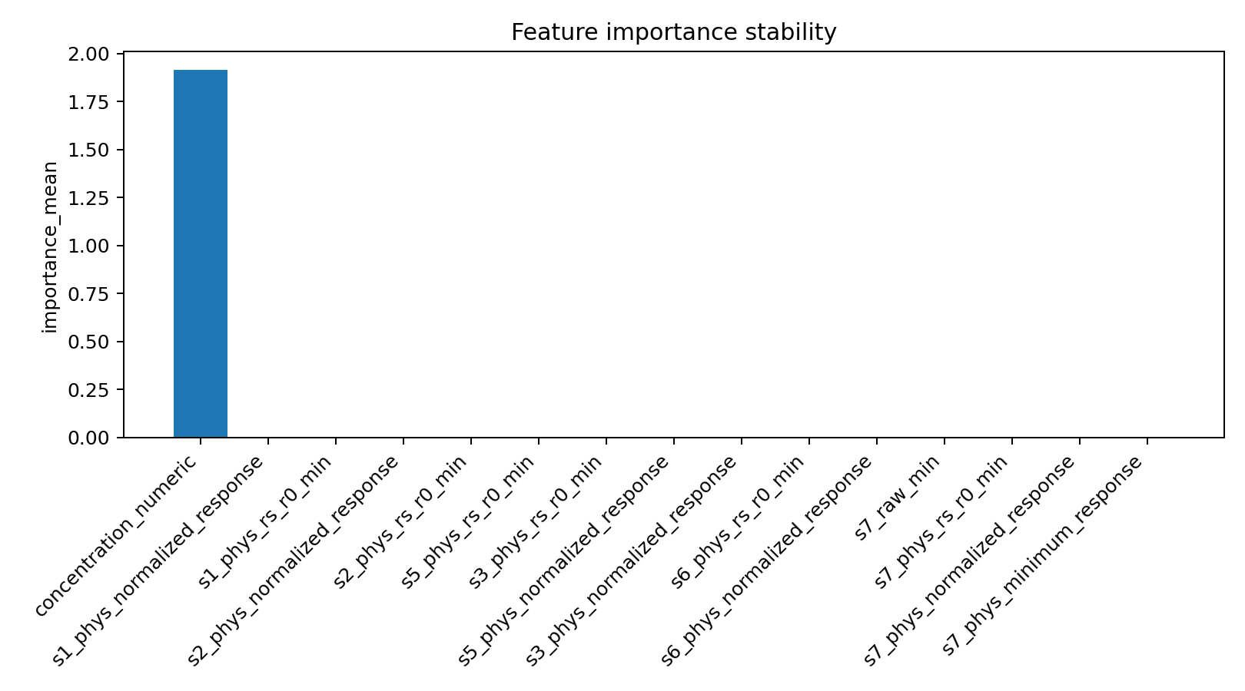
day4_feature_importance_stability.png
Figure 1 After Updating
Figure 2 before Updating

Slide 4
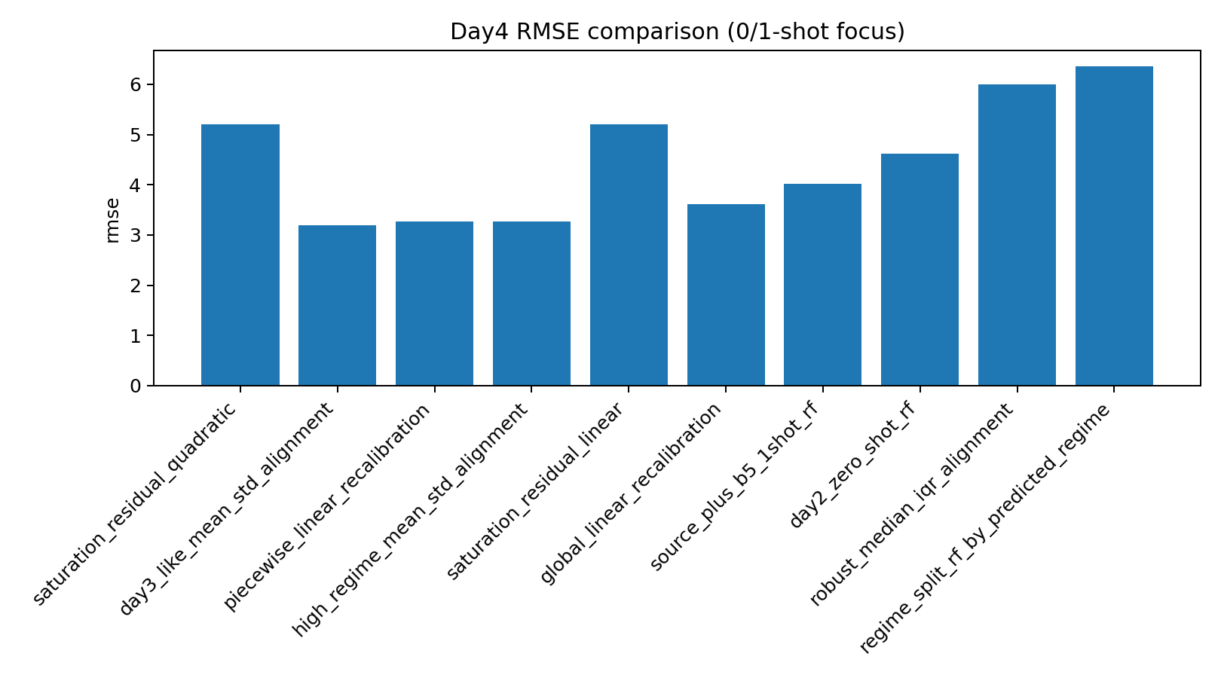
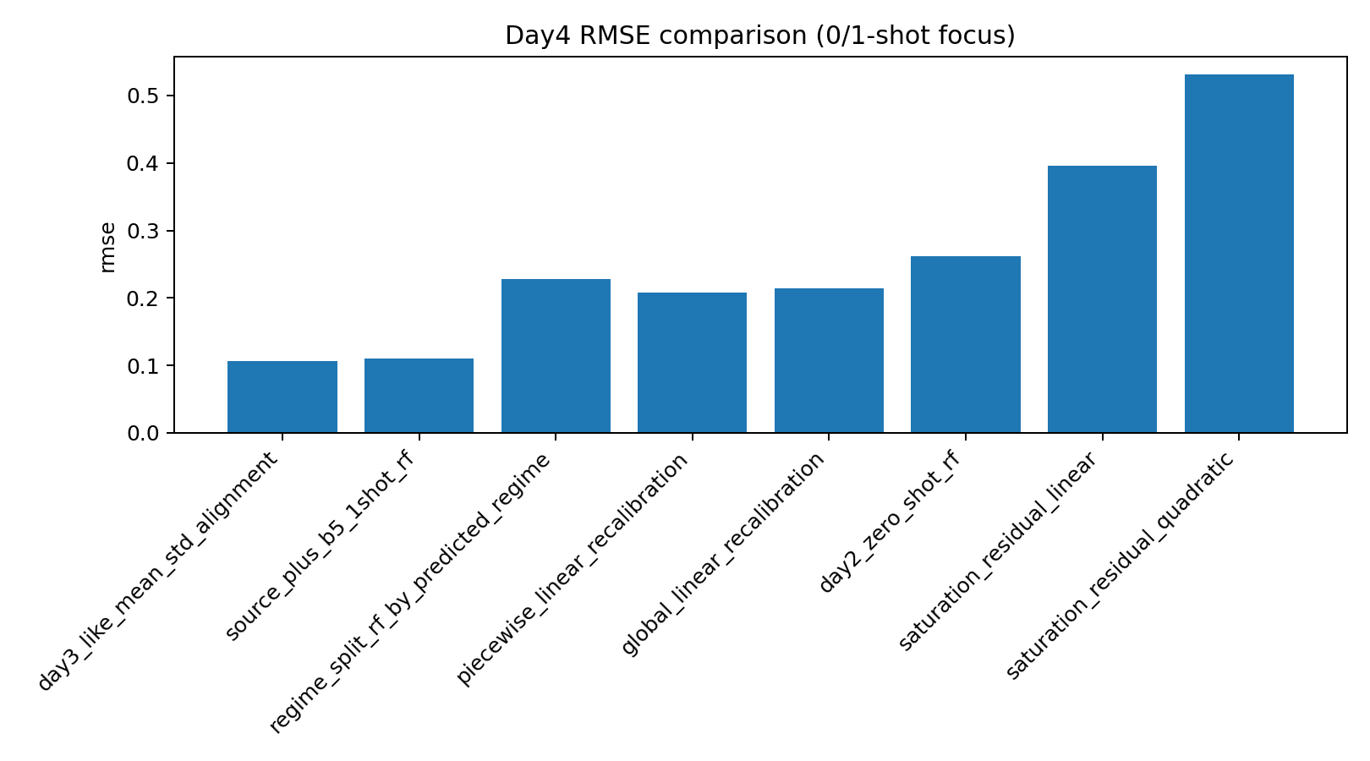
day4_rmse_comparison.png
Figure 1 After Updating
Figure 2 before Updating

